Slide 1

Project First Review on
POWER SYSTEM FAULT DIAGNOSIS USING MACHINE LEARNING
by
under the guidance of
Dr . S. Hemachandra M.Tech., Ph.D.
Professor
DEPARTMENT OF ELECTRICAL AND ELECTRONICS ENGINEERING
SREE VIDYANIKETHAN ENGINEERING COLLEGE
(AUTONOMOUS)
A.RANGAMPET, TIRUPATI – 517 102
(2016 - 2020)
EDAGOTTI PAVANKUMAR | 16121A0253
AVILALA DEDEEPYA | 16121A0208
GAYAKAWADA CHANDRASEKHAR | 16121A0265
AVULA PRAVALIKA | 16121A0209

Slide 2
Contents :
Objective
Introduction
Literature Survey
Research gap
Applications
Conclusion
Project Time line
References

Slide 3
Objective
Power system fault diagnosis is the process of analyzing historical fault data to detect and predict current or future fault.
The objective of our project is to find out the faults in the transmission line and to classify them using the neural networks.

Slide 4
Introduction
In recent years, artificial intelligence technologies are becoming more and more popular due to its amazing features.
Application of artificial intelligence techniques in the electric power industry which is currently undergoing extraordinary development.
One of the most thrilling and potentially cost-effective recent developments in this field is increasing usage of artificial intelligence techniques viz neural network, genetic algorithm, fuzzy logic, and expert systems.

Slide 5
(Cont..)
The training mechanism of deep learning is layer-wise pre-training mechanism.
Deep learning also has great learning ability so it focuses on the field of machine learning and artificial intelligence.

Slide 6
Literature Survey
In 2015, Majid Jamil, Sanjeev Kumar Sharma, and Rajveer Singh published a paper to determine and classify the faults using a back-propagation neural network.
In 2016, Y. Wang, M. Liu, Z. Bao published a paper for the power system fault diagnosis using stacked auto-encoders to train the deep neural network.
In 2017, Florian Rudin, Guo-Jie Li, Keyou Wang published a paper to use the Convolution Neural Networks for fault diagnosis.
In 2017, Gabriel Michau, Thomas Palm, Olga Fink published a paper on HELM for the power system fault diagnosis.
In 2017, Biswarup Bhattacharya, Abhishek Sinha published a paper on fault analysis using Recurrent Neural Networks.

Slide 7
Research Gap
The artificial neural networks are not up to the mark when we compared the performance with the deep learning neural networks.
There are many architectures of deep neural networks. In these networks, some are application-specific.

Slide 8
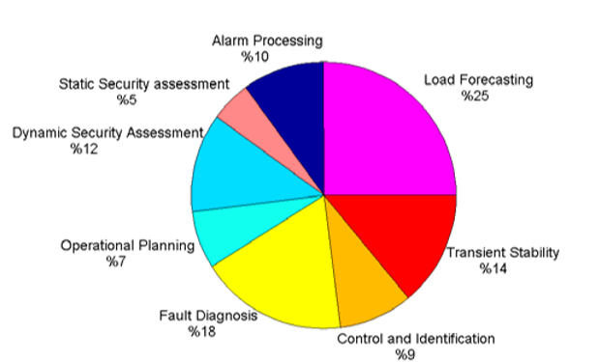
Neural network applications in power system
(Cont..)

Slide 9
Applications
The faults in the power system will play a major role in the system stability
Fault classification is important for the operation of the healthy phases.
Power system reliability gets improved.

Slide 10
Conclusion
This project is to develop a deep neural network so that the power system faults can be diagnosed. We will try to classify them as much faults as possible using deep neural networks and further improvements in the project will be informed.

Slide 11
Project Time Line
S.No | Work | No. of Weeks | Tentative Dates
1 | Commencement of Project Work | - | 02 – 12 – 2019
2 | Project tittle conformation and submission of Abstract | 2 weeks | 16 – 12 – 2019
3 | Literature Survey | 1 week | 23 – 12 – 2019
4 | Learning Neural Networks | 3 weeks | 13 – 01 – 2020
5 | Learning Software | 3 weeks | 03 – 02 – 2020
6 | Simulating the Neural Network | 6 weeks | 19 – 03 – 2020
7 | Submission of project thesis | 2 weeks | 30 – 03 – 2020

Slide 12
References
[1] | Y. Wang, M. Liu and Z. Bao, "Deep learning neural network for power system fault diagnosis," 2016 35th Chinese Control Conference (CCC), Chengdu, 2016, pp. 6678-6683.
[2] | Michau, Gabriel & Palmé, Thomas & Fink, Olga. (2017). Deep Feature Learning Network for Fault Detection and Isolation.
[3] | Florian Rudin, Guo-Jie Li and Keyou Wang, “An Algorithm for Power System Fault Analysis based on Convolutional Deep Learning Neural Networks”, International Journal of All Research Education and Scientific Methods (IJARESM), Volume 5, Issue 9, September- 2017.
[4] | B. Bhattacharya and A. Sinha, "Intelligent Fault Analysis in Electrical Power Grids," 2017 IEEE 29th International Conference on Tools with Artificial Intelligence (ICTAI), Boston, MA, 2017, pp. 985-990.
[5] | H. A. Tokel, R. A. Halaseh, G. Alirezaei and R. Mathar, "A new approach for machine learning-based fault detection and classification in power systems," 2018 IEEE Power & Energy Society Innovative Smart Grid Technologies Conference (ISGT), Washington, DC, 2018, pp. 1-5.
[6] | G. Cardoso, J. G. Rolim and H. H. Zurn, "Application of neural-network modules to electric power system fault section estimation," in IEEE Transactions on Power Delivery, vol. 19, no. 3, pp. 1034-1041, July 2004.
[7] | Jamil, M., Sharma, S.K. & Singh, R. SpringerPlus (2015) 4: 334. https://doi.org/10.1186/s40064-015-1080-x.

Slide 13


